Slide 1
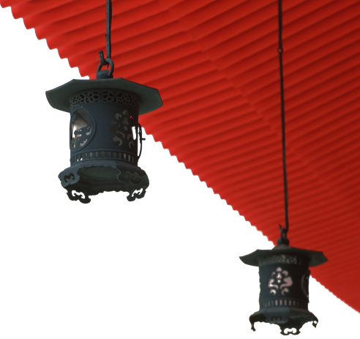


中国文化概况
A GLIMPSE OF CHINESE CULTURE

Slide 2
Philosophy
and
Religions

Slide 3

学习目标
了解中国古代哲学发展及内容；
掌握中国主要宗教的基本概况;
继承和发扬中国传统美德。

Slide 4
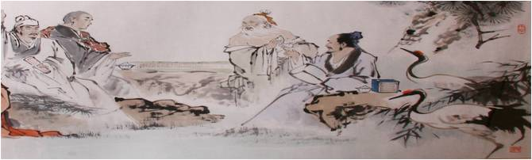
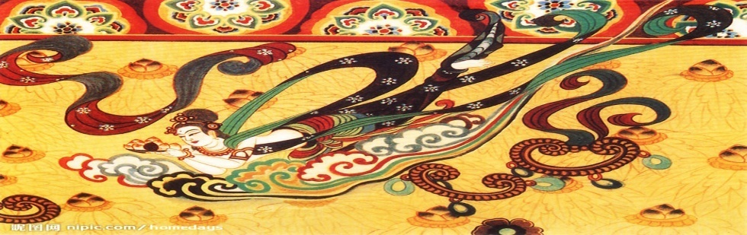
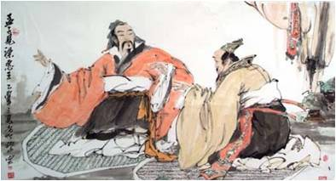
1
2
Overview
3
Lead-in Activity
knowledge Study
Discussion &
Presentation

Slide 5

Lead-in Activity
Haha, there you go ...

Slide 6
1
2
Overview
3
Lead-in Activity
Text Study
Discussion &
Presentation

Slide 7
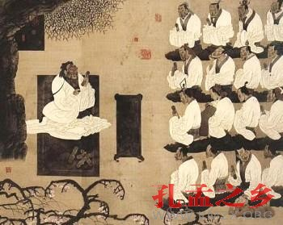
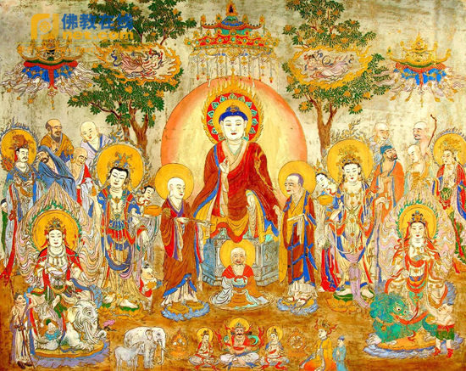
1
2
Chinese Philosophy
Chinese Religions

Slide 8
Chinese Philosophy
the collective designation ( 总称) for the various
schools of thought in China
one of the three philosophy systems in the world
developed independently with its own distinguishing
features, unique concept systems and expressive ways
the soul of traditional Chinese culture
has developed over several thousand years

Slide 9
Chinese Philosophy
The Development of Chinese Philosophy
The Basic Features of Chinese Ancient
Philosophy
Characteristics of Chinese Ethics and
Morality

Slide 10
The Development of Chinese Philosophy
Outline
origins from the Xia, Shang, and Zhou dynasties
began to take definite shape during the Spring and
Autumn Period
enjoyed thriving development because of the
emergence of the “contention and flourishing of
numerous schools of thought”

Slide 11
The Development of Chinese Philosophy
● The philosophy in Pre-Qin times (先秦子学)
● The orthodox philosophy during the Han Dynasty (两汉经学)
● Metaphysics during the Wei and Jin dynasties (魏晋玄学)
● The buddhist philosophy during the Sui and Tang dynasties
(隋唐佛学)
● Neo-confucianism in Song and Ming dynasties (宋明理学)
● Application philosophy in the Ming and Qing dynasties
(明清实学)

Slide 12
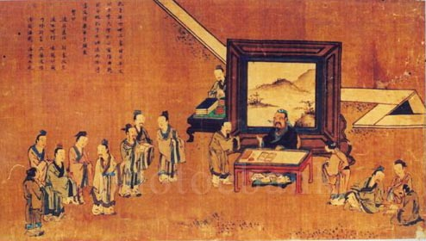
The Development of Chinese Philosophy
The philosophy in Pre-Qin times
The philosophy in Pre-Qin times
was marked by the emergence of
various ancient philosophical
views.
The most influential schools were
Confucianism (儒家), Taoism (道家),
Mohism (墨家) and Legalism (法家)

Slide 13
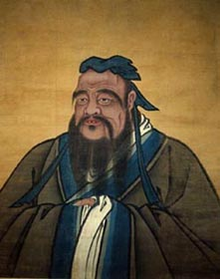
The Development of Chinese Philosophy
Philosophy During the Pre-Qin Times ( 先秦子学)
Confucianism
takes the teachings of Confucius as its core
of thought
regards the words and deeds of Confucius
as its highest code (准则) of behavior.
advocates:
the benevolence and justice,
allegiance and forbearance (仁、义、忠、恕),
the doctrine of the golden mean (中庸)
the ethical relations of men
family and social order

Slide 14
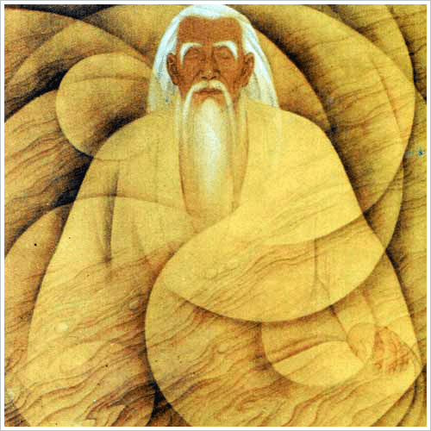
The Development of Chinese Philosophy
Philosophy During the Pre-Qin Times ( 先秦子学)
Taoism
Founded by Lao Zi and Zhuang Zi
Dao is the course, the principle, the substance, and the standard of all things, to which all of them must conform
Based on the work of Daodejing, Taoism promotes the belief that a person should live a simple life
favours the political principle of “achieving good government through non-action”(无为而治)

Slide 15
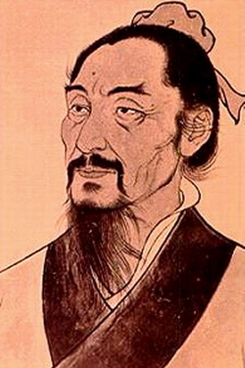
The Development of Chinese Philosophy
Philosophy During the Pre-Qin Times ( 先秦子学)
Mohism
base on the teaching of Mozi
cherishes universal love
honors virtuous people,
opposes fatalism (宿命论) and aggressive wars
upholds thriftiness and simple funerals

Slide 16
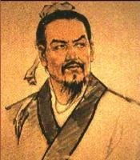
The Development of Chinese Philosophy
Philosophy During the Pre-Qin Times ( 先秦子学)
Legalism
begun by Hanfeizi
espouses (主张) laying down laws to unify the thought of people
promotes agriculture to achieve affluence (富裕)
wages (进行) wars to gain strength and power
establishes a system of bureaucracy (官僚制度)

Slide 17
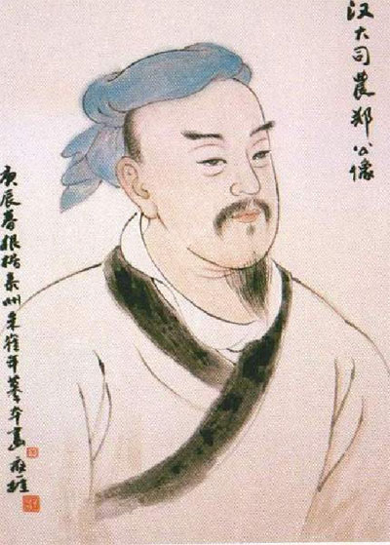
The Development of Chinese Philosophy
Orthodox Philosophy During the Han Dynasty ( 两汉经学)
“banning all schools of thought except Confucianism ( 罢
黜百家，独尊儒术)”
Confucianism served as the ideological foundation of the
feudal rule.
Orthodox philosophy advocates that Heaven affects
human affairs and human behaviour finds responses in
Heaven (天人感应).
the power of the emperors are authorized by Heaven
(君权神授).
at odds with Confucianism which holds that man is an
integral part of nature (天人合一)

Slide 18

The Development of Chinese Philosophy
Metaphysics During the Wei and Jin Dynasties ( 魏晋玄学)
blended Confucianism and Laozi’s doctrines
based on The Book of Changes (《易经》), Daodejing
and Zhuangzi, known as the “three profound studies ( 三
玄)”
theme: To explore the noumenon ( 本体) of the universe
mainly discusses the propositions of :
“existence versus non-existence”
“essentials（本质） versus non-essentials”
“words versus ideas”
“fundamentals versus practice”
“ethics versus nature”, etc.

Slide 19
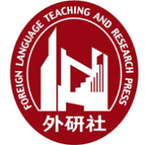
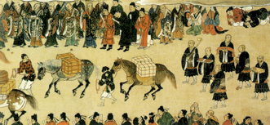
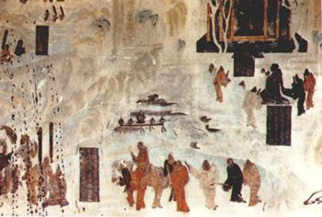
The Development of Chinese Philosophy
Buddhist Philosophy During the Sui and Tang Dynasties ( 隋唐佛学)
reached its apex ( 顶点) during the Sui and Tang
dynasties
mainly discusses the relationship between the
subjective and the objective
attempts to gain insight into the universe and
human life

Slide 20
The Development of Chinese Philosophy
Neo-Confucianism During the Song and Ming Dynasties ( 宋明理学)
A new Confucianism developed by incorporating
Taoism and Buddhism
mainly discusses the relationship between human
beings, between man and nature, and between man
and society, as well as the nature of human beings
two main schools: the School of Principle (理学)
the School of Mind (心学)

Slide 21
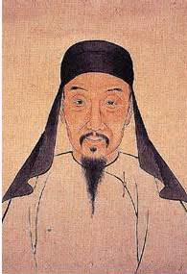
The Development of Chinese Philosophy
Application Philosophy During the Ming and Qing Dynasties ( 明清实学)
focused on “self-examination”
stuck to the application of philosophy
on the state affairs
searches for the answers to specific
issues instead of abstract study
encourages creative ideas

Slide 22
Chinese Philosophy
The Development of Chinese Philosophy
The Basic Features of Chinese Ancient
Philosophy
Characteristics of Chinese Ethics and
Morality

Slide 23
The Basic Features of Chinese Ancient Philosophy
Stress on spiritual existence
Stress on practice
Stress on morality
Stress on harmony
Stress on intuition

Slide 24
The Basic Features of Chinese Ancient Philosophy
Stress on spiritual existence
All ancient Chinese philosophers paid attention to the study of existence, striving to achieve the highest spiritual state.
Can you find any example for this feature?
Confucianism’s knowledge of life through disposition and consciousness
Taoism’s search for spiritual freedom
Buddhism’s “Nirvana” (涅磐)

Slide 25
The Basic Features of Chinese Ancient Philosophy
Stress on practice
Chinese ancient philosophers were concerned with the relationship between knowledge and practice.
e.g.
“To prefer it is better than only to know it. To delight in it is better than merely to prefer it, To delight in it is better than merely to prefer it.”(知之者不如好之者，好之者不如乐之者。)

Slide 26
The Basic Features of Chinese Ancient Philosophy
Stress on morality
Every school of ancient Chinese philosophy was a kind of moral philosophy. Almost every philosophy stressed moral practice.
e.g.
benevolence, loyalty, filial piety ( 孝顺), respect, mutual trust, etc.

Slide 27
The Basic Features of Chinese Ancient Philosophy
Stress on harmony
stresses on harmony, and the pursuit of harmony between man and nature and also between man and man.
e.g.
Mencius said “Opportunities vouchsafed by Heaven are less important than terrestrial advantages, which in turn are less important than the unity among people. (天时不如地利，地利不如人和) ”

Slide 28
The Basic Features of Chinese Ancient Philosophy
Stress on intuition
did not adhere to formal rules of structure and system in thought
often resulted in fragmented (片断的) thoughts written on paper
It was through reflecting on life’s experiences and intuition that philosophical ideas were formed.
e.g.
Chinese Chan Buddhism ( 禅宗), preaches epiphany ( 顿悟) and emphasises self-restraint and self-reflection by sitting still and reciting Buddhist scriptures ( 经文).

Slide 29
Chinese Philosophy
The Development of Chinese Philosophy
The Basic Features of Chinese Ancient
Philosophy
Characteristics of Chinese Ethics and
Morality

Slide 30
Characteristics of Chinese Ethics and Morality
Positive:
Seeking Harmony and Maintaining Equilibrium(平衡)
Collectivism over Individualism
Spiritual Life over Material Life
Negative:
three obediences and four virtues
the three cardinal guides and five constant virtues

Slide 31
Characteristics of Chinese Ethics and Morality
Seeking Harmony and Maintaining Equilibrium
seeks peace, compromise, concord ( 一致),unison ( 调和)
Maintaining equilibrium is the ultimate purpose of harmony

Slide 32
Characteristics of Chinese Ethics and Morality
Collectivism over Individualism
Traditional Chinese values attach great importance to
collective interest.
The interest of the society, the country and the family
has always been given top priority.
An individual’s values can be realized only within society
as a whole, as that is the groundwork of one’s existence.

Slide 33
Characteristics of Chinese Ethics and Morality
Spiritual Life over Material Life
advocate morality in daily behavior
Self-cultivation in morals is emphasized, and is
considered to be more important than one’s
material life.
e.g.
showing filial obedience, being amiable ( 友善的)
to others, respecting ordinary people and
appreciating moral conduct

Slide 34
1
2
Chinese Philosophy
Chinese Religions

Slide 35
Chinese Religions
overview
China is a multi-religion country.
indigenous religion: Taoism
religions of foreign origin: Buddhism, Islam, Catholicism and Christianity
Among the four religions of foreign origin, Buddhism and Islam are comparatively more influential in China.

Slide 36
The Taoist Religion
an indigenous (土生土长的) religion in China.
Lu Xun once said, “The Chinese roots are deep in Taoism. If one tries to comprehend Chinese history and culture, he must first comprehend Taoism and the Taoist religion.”
evolved out of witchcraft (巫术), necromancy (方术 ) and self-cultivation techniques.
highest belief: Dao

Slide 37
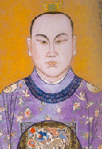
The Taoist Religion
Development
founder: Zhang Daoling (“Tianshi”)
founded in the Eastern Han dynasty
developed during the Sui and Tang dynasty
became very popular during the Southern and Northern dynasties
declined during the Ming dynasty

Slide 38
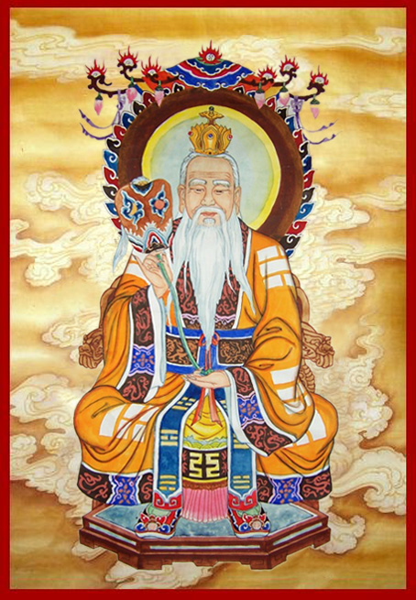
The Taoist Religion
Taishang laojun
revered (尊崇) as the originator of the Taoist religion
was called him “Taishang Laojun”
(太上老君).

Slide 39
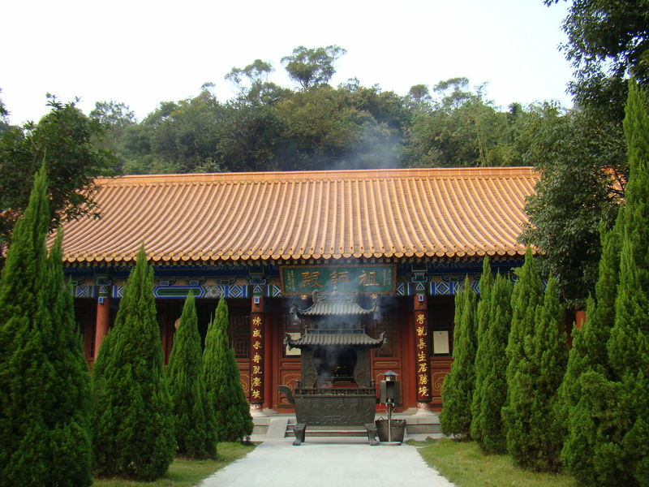
The Taoist Religion
Taoism Temples
places for Taoist priests to carry out their religious activities.
The layout evolved from the traditional square-shaped Chinese courtyard, also resembling that of Buddhist temples in design.
In front of Taoist temples, there are mountain gates, Huabiao (marble pillar) and fan’gan (幡杆).
Outside the Huabiao is the earthly world (俗界), inside it is the celestial place (仙界).
In the main hall are enshrined the Three Pure Gods ( 三清) of Jade Pure ( 玉清), Upper Pure ( 上清) and Great Pure ( 太清).

Slide 40
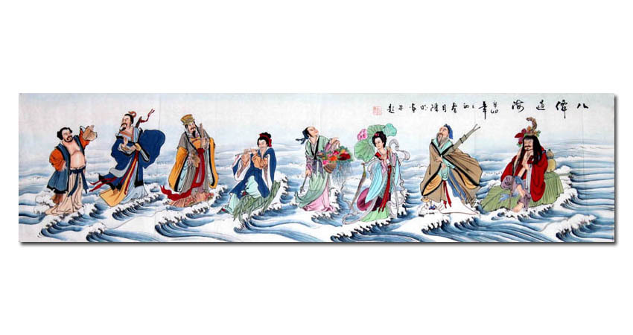
The Taoist Religion
Eight Immortals in the Taoist Religion
popularly worshipped by Taoist believers as well as
ordinary people
“When theEight Immortals cross the sea, each demonstrates
their divine power. ( 八仙过海，各显神通)”
represent eight factors in daily life
held common, everyday items in their hands, endearing
them to Taoist believers as well as to ordinary Chinese people

Slide 41

The Taoist Religion
Taoist mountain
Dragon-Tiger Mountain
located at the southwestern suburb of Yingtan, Jiangxi Province
the most sacred Taoist mountain
the birthplace of the Taoist religion
According to a legend, when the
elixirs（长生不老药） were made, a dragon and a tiger were seen above the mountain. So, the mountain was renamed after the celestial animals (“丹成而龙虎现，山因以名”).

Slide 42
Buddhism
originated in India in the sixth century B.C.
Sakyamuni is said to be the founder of Buddhism.
first introduced into China in the first century
entered its golden age during the Sui and Tang dynasties
based on the theory of samsara (轮回), meaning that living beings orbit around the six spheres of heaven, hell and earth, just like an ever-turning wheel

Slide 43
Buddhism
The Buddhist doctrines
Everything in the world is changing transient ( 暂时的)
and unreal.
There is no independent entity ( 实体) or dictator.
Life is suffering.
Four Noble Truths (四谛):
Life is suffering.
The cause of suffering is desire.
The answer is to quench (抑制) desire.
The way to this end is to follow the Eight-Fold Path (八正道).

Slide 44
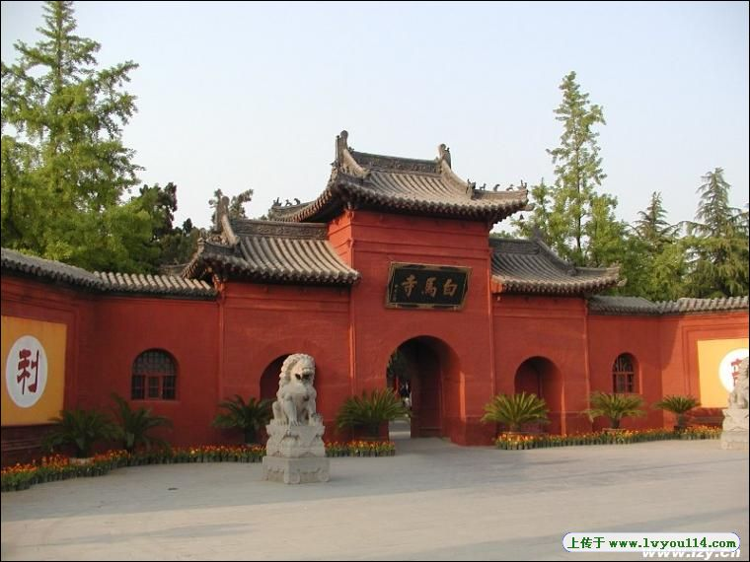
Buddhism
Buddhist Temples
Chinese Buddhist architecture includes pagodas（佛塔）, temples and grottos（洞穴）. Earlier Buddhist temples usually combined pagodas and a courtyard-style temple.
The White Horse Temple
located in Luoyang City, Henan Province
first officially built Buddhist temple in China
named after the white horse that carried the Buddhist scriptures from India to Luoyang

Slide 45
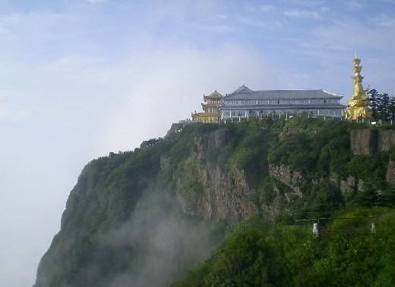


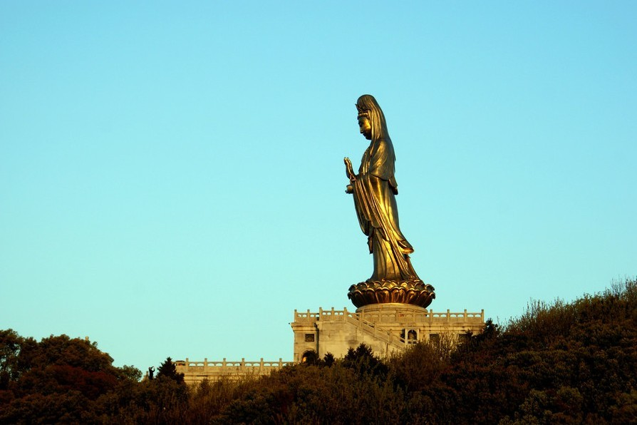
Buddhism
Buddhist Mountains
Emei Mountain 峨眉山
WuTai Mountain五台山
Jiuhua Mountain 九华山
Putuo Mountain普陀山

Slide 46
Overview
Discussion &
Presentation

Slide 47

Discussion
The main stream of traditional Chinese culture is Confucianism, the core of which is the doctrine of the golden mean. Can you cite an example in your real life to illustrate your understanding of the doctrine?

Slide 48
Students’ Presentation
You are a member of the Classic Culture Association in your university. In order to celebrate Confucius’ birthday, the association decides to hold a Confucius Cultural Festival ( 孔子文化节) on 28 March. You are assigned to be in charge of it. Please discuss with your group members and present a detailed proposal to the association.
The proposal should cover the following points:
1 purpose of the festival
2 the activities to be held in the festival
3 the desired outcome

Slide 49
The End

